Slide 1
Rethinking Atrous Convolution for Semantic Image Segmentation
COMPUTER VISION LAB
22211226 Ju-Hyeon Nam

Slide 2
Contents
Introduction
Methods
Experiment Results
Implementations

Slide 3
Contents
Introduction
Methods
Experiment Results
Implementations

Slide 4
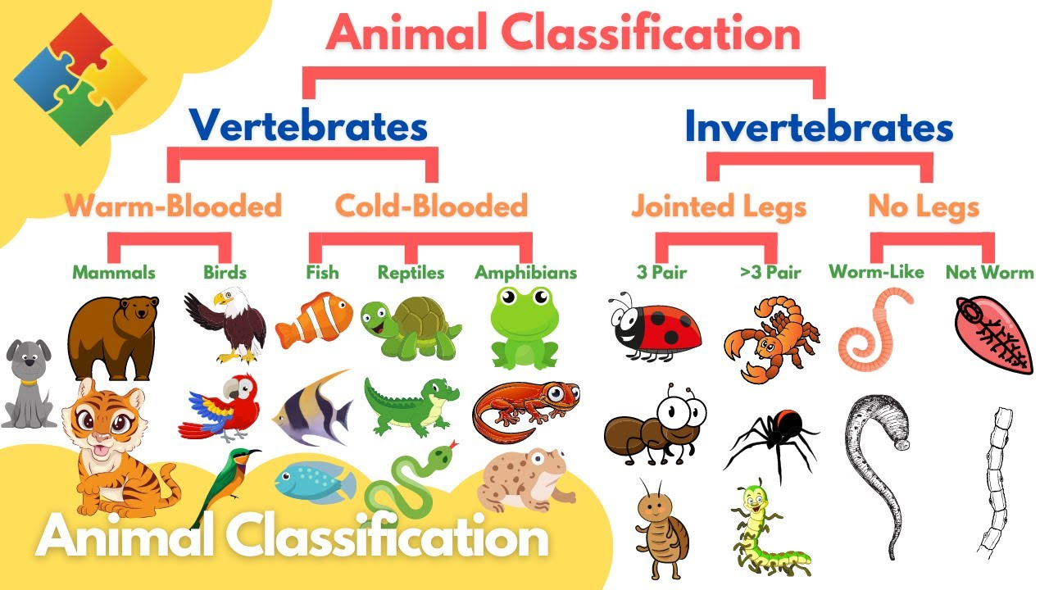
Introduction
Applications of Deep Convolutional Neural Networks
Image Classification

Slide 5
Introduction
Applications of Deep Convolutional Neural Networks
Image Classification
A. Krizhevsky, I. Sutskever, and G. E. Hinton, “Imagenet classification with deep convolutional neural networks,” in NIPS, 2013.
P. Sermanet, D. Eigen, X. Zhang, M. Mathieu, R. Fergus, and Y. LeCun, “Overfeat: Integrated recognition, localization and detection using convolutional networks,” arXiv:1312.6229, 2013.
K. Simonyan and A. Zisserman, “Very deep convolutional networks for large-scale image recognition,” in ICLR, 2015.
C. Szegedy, W. Liu, Y. Jia, P. Sermanet, S. Reed, D. Anguelov, D. Erhan, V. Vanhoucke, and A. Rabinovich, “Going deeper with convolutions,” arXiv:1409.4842, 2014.
G. Papandreou, I. Kokkinos, and P.-A. Savalle, “Modeling local and global deformations in deep learning: Epitomic convolution, multiple instance learning, and sliding window detection,” in CVPR, 2015.

Slide 6
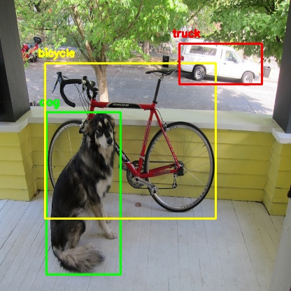
Introduction
Applications of Deep Convolutional Neural Networks
Object Detection

Slide 7
Introduction
Applications of Deep Convolutional Neural Networks
Object Detection
R. Girshick, J. Donahue, T. Darrell, and J. Malik, “Rich feature hierarchies for accurate object detection and semantic segmentation,” in CVPR, 2014.
D. Erhan, C. Szegedy, A. Toshev, and D. Anguelov, “Scalable object detection using deep neural networks,” in CVPR, 2014.
R. Girshick, “Fast r-cnn,” in ICCV, 2015.
S. Ren, K. He, R. Girshick, and J. Sun, “Faster r-cnn: Towards realtime object detection with region proposal networks,” in NIPS, 2015.
K. He, X. Zhang, S. Ren, and J. Sun, “Deep residual learning for image recognition,” arXiv:1512.03385, 2015.
W. Liu, D. Anguelov, D. Erhan, C. Szegedy, and S. Reed, “SSD: Single shot multibox detector,” arXiv:1512.02325, 2015.

Slide 8
Introduction
Applications of Deep Convolutional Neural Networks
Characteristic Architecture in Image Classification and Object Detection
Invariance of DCNN to local image transformations
Abstract data representation!!
Hamper dense prediction task(Segmentation)

Slide 9
Introduction
Challenge in Semantic Image Segmentation
1. Reduced Feature Resolution
2. Existence of object at multiple scales
3. Reduced localization accuracy due to DCNN invariance

Slide 10
Introduction
Challenge in Semantic Image Segmentation
1. Reduced Feature Resolution
CAUSE : The repeated combination of max-pooling and downsampling performed at consecutive layers of DCNNs
A. Krizhevsky, I. Sutskever, and G. E. Hinton, “Imagenet classification with deep convolutional neural networks,” in NIPS, 2013.
K. Simonyan and A. Zisserman, “Very deep convolutional networks for large-scale image recognition,” in ICLR, 2015.
C. Szegedy, W. Liu, Y. Jia, P. Sermanet, S. Reed, D. Anguelov, D. Erhan, V. Vanhoucke, and A. Rabinovich, “Going deeper with convolutions,” arXiv:1409.4842, 2014.
Solution
Remove the downsampling operator from the last few max pooling layers of DCNNs
Upsample the filters in subsequent convolutional layer
Atrous Convolution
Image Classification Architecture

Slide 11
Introduction
Challenge in Semantic Image Segmentation
2. Existence of object at multiple scales
Standard Solution
Present to the DCNN rescaled version of the same image
Aggregate the feature or score maps
G. Papandreou, I. Kokkinos, and P.-A. Savalle, “Modeling local and global deformations in deep learning: Epitomic convolution, multiple instance learning, and sliding window detection,” in CVPR, 2015.
L.-C. Chen, Y. Yang, J. Wang, W. Xu, and A. L. Yuille, “Attention to scale: Scale-aware semantic image segmentation,” in CVPR, 2016.
I. Kokkinos, “Pushing the boundaries of boundary detection using deep learning,” in ICLR, 2016
Solution
Spatial Pyramid Pooling(SPP)
S. Lazebnik, C. Schmid, and J. Ponce, “Beyond bags of features: Spatial pyramid matching for recognizing natural scene categories,” in CVPR, 2006.
K. He, X. Zhang, S. Ren, and J. Sun, “Spatial pyramid pooling in deep convolutional networks for visual recognition,” in ECCV, 2014.
Atrous Convolution + SPP = ASPP

Slide 12
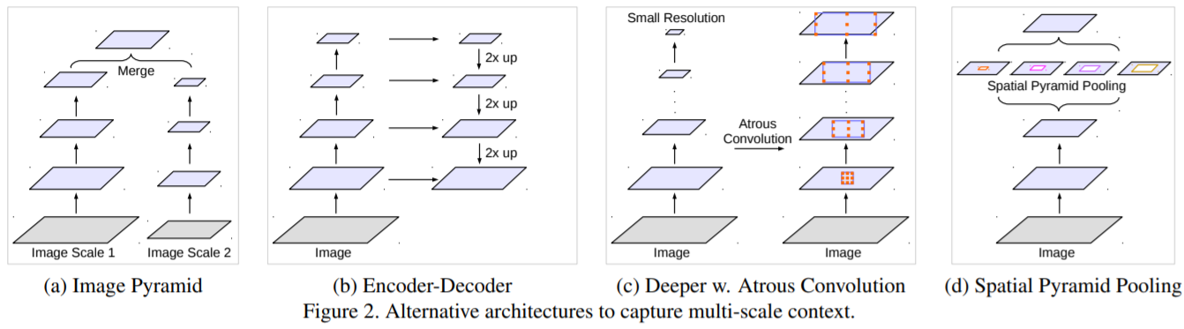
Introduction
Challenge in Semantic Image Segmentation
2. Existence of object at multiple scales

Slide 13
Introduction
Challenge in Semantic Image Segmentation
3. Reduced localization accuracy due to DCNN invariance
CAUSE : An object centric classifier requires invariance to spatial transformations
Solution
Fully Connected Conditional Random Field(CRF)

Slide 14
Contents
Introduction
Methods
Experiment Results
Implementations

Slide 15
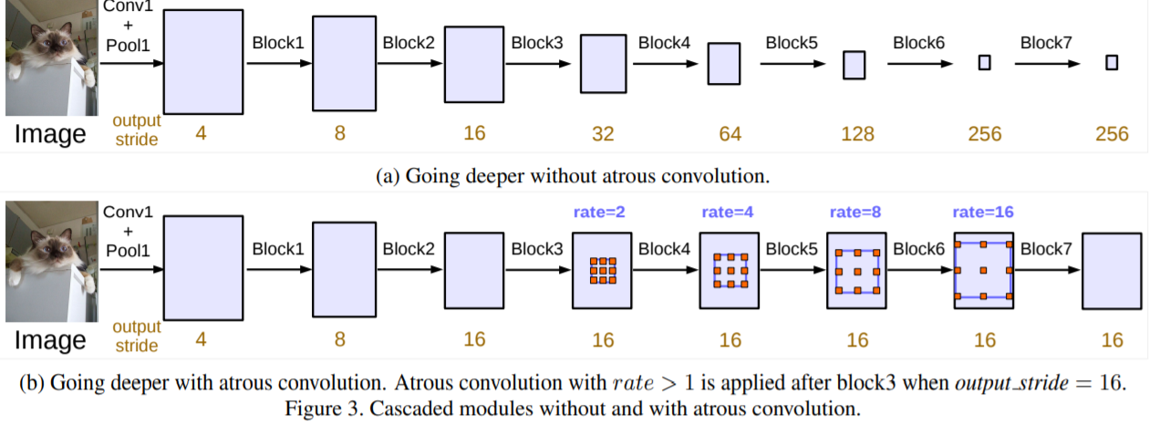
Methods
Overall Algorithm
Cascade…

Slide 16
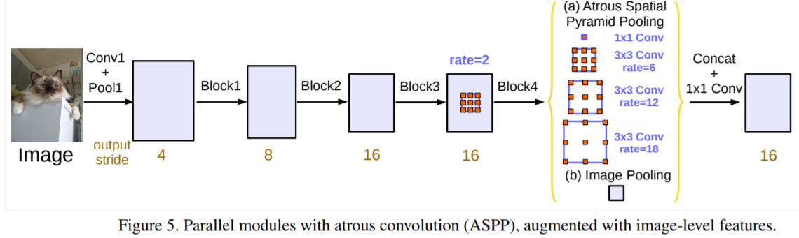
Methods
Overall Algorithm
Parallel…

Slide 17
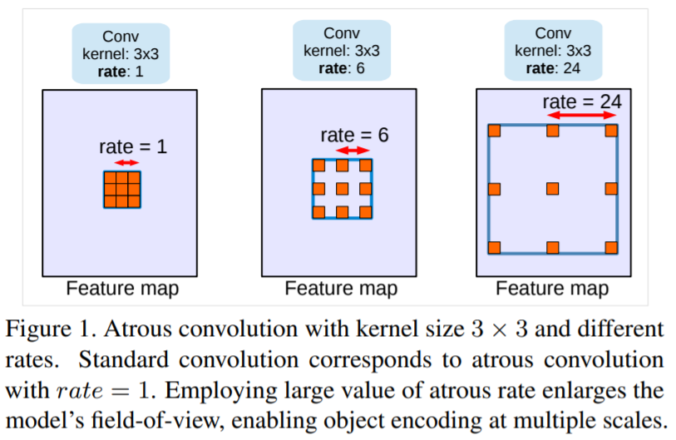

Methods
Atrous Convolution for Dense Feature Extraction
Atrous Convolution
$$y\left[i\right]=\sum_{k=1}^{K}{x\left[i+r∙k\right]w[k]}$$
$r$ : rate parameter
$r=1$ : Standard convolution
Output stride = input resolution / output resolution

Slide 18
Methods
Atrous Convolution for Dense Feature Extraction
Atrous Convolution

Slide 19
Contents
Introduction
Methods
Experiment Results
Implementations

Slide 20

Experiment Results
Experiment Settings
ImageNet-pretrained ResNet
Dataset : PASCAL VOC2012 Semantic Segmentation Benchmark
Learning rate Policy : $Next lr=Current lr ∗{(1−\frac{iter}{max⁡_iter})}^{0.9}$
Crop Size : $513 ×513$
Batch Normalization
Data Augmentation
Randomly Scaling(0.5 ~ 2.0)
Horizontal Flipping

Slide 21
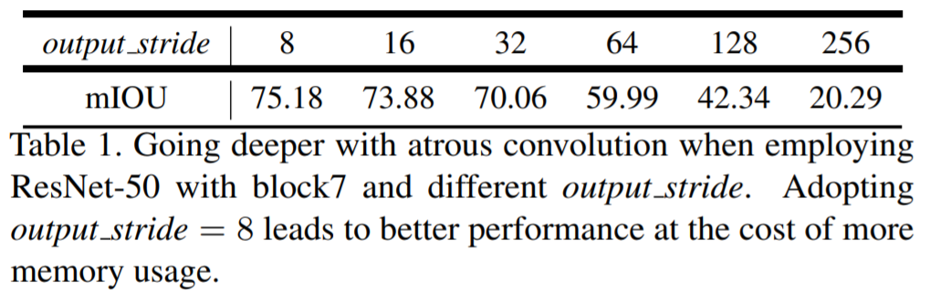
Experiment Results
Going Deeper with Atrous Convolution
ResNet50

Slide 22
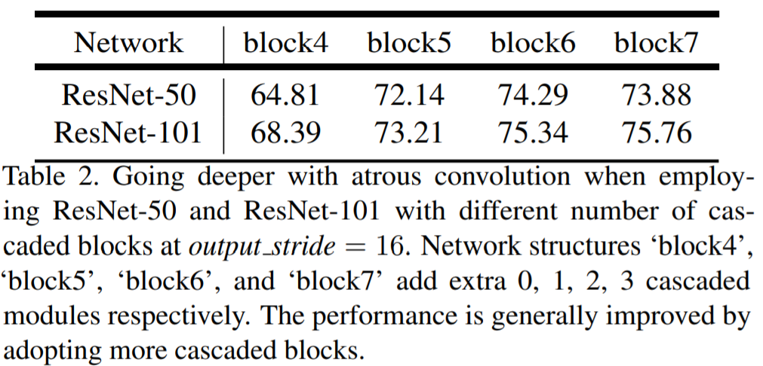
Experiment Results
Going Deeper with Atrous Convolution
ResNet50 vs ResNet101

Slide 23
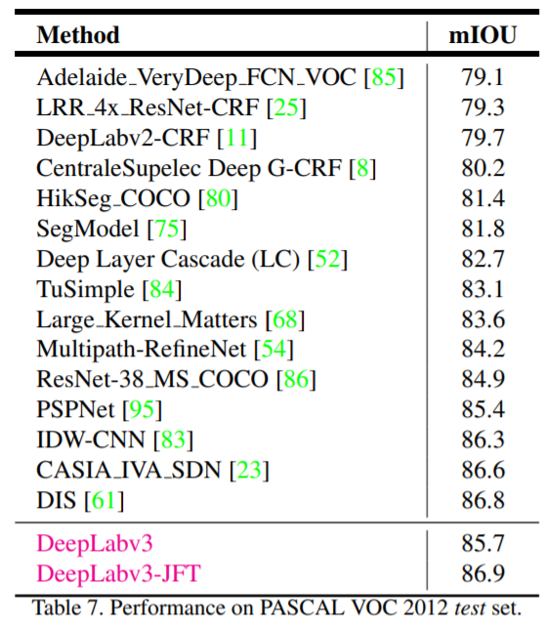
Experiment Results

Slide 24
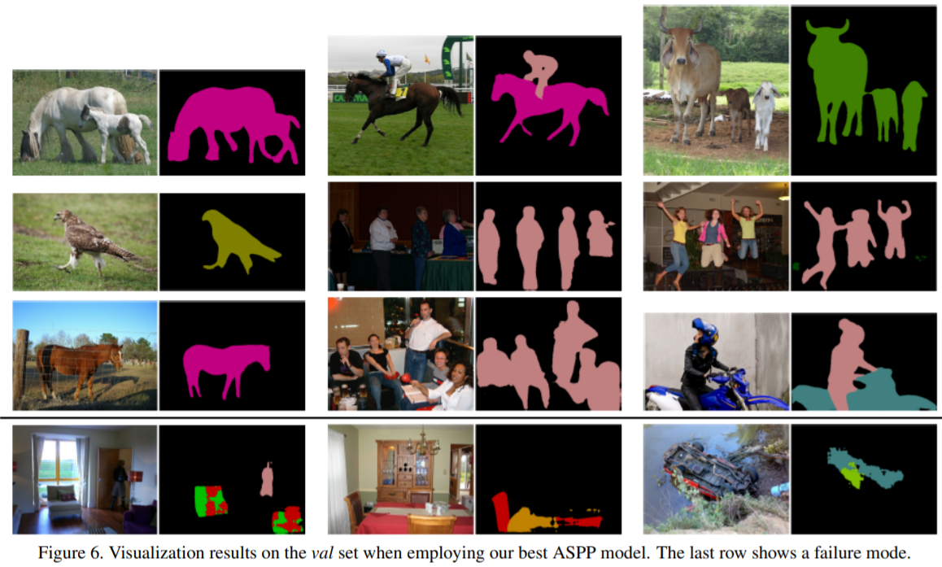
Experiment Results

